Slide 1


Safer, further, together with Delta Air Lines
Why air travel is still a safer mode of transportation than others
By phil han
Notes:
Are you still afraid of flying in the sky?
Recently, the media have been portraying flying as a highly dangerous way to travel. Our Data Science team has found the accurate data and facts to prove the media wrong. We can show you how safe and secure your next flight to your destination will be. So fasten your seatbelt and come with us to find out yourself!

Slide 2
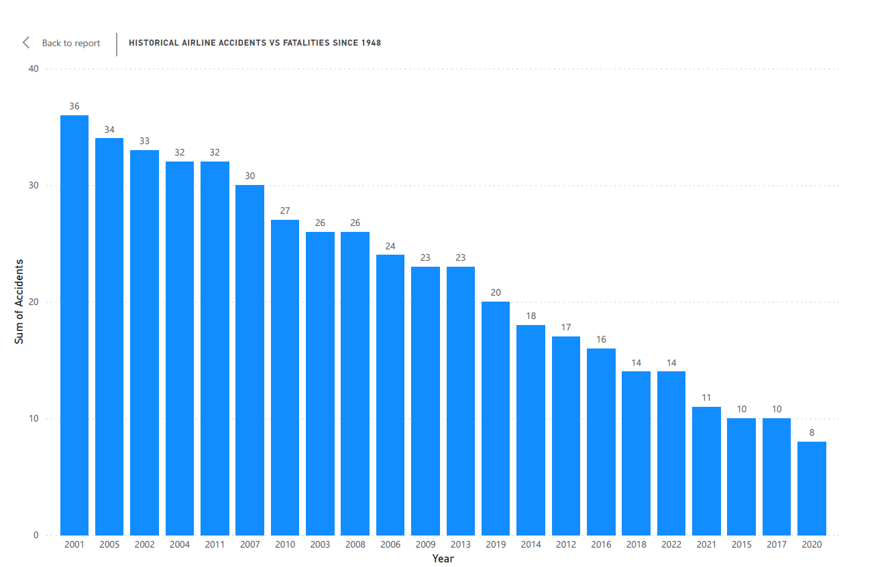
Safer than ever before
Over last 35 years, air travelers have encountered fewer than 40 accidents per year.
With commercial air regulations, accidents have been on a downward trend-- even less than 20 accidents for the most of last 10 years
Notes:
First of all, facts on the likelihood of dying in a plane crash.
1 in 3.37 billion chances of dying in a commercial airline plane crash between 2012-2016

Slide 3
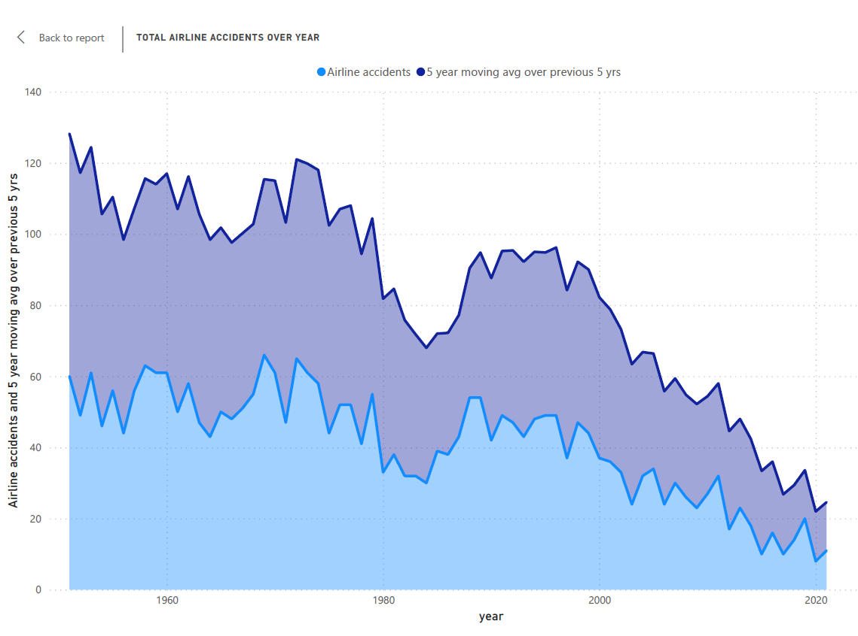

“If you took one domestic flight a day, every day of the week, odds are you could go 36,000 years before you’d die in a plane crash.”
-Dr. Arnold Barnett, MIT
Source: Air Travel –MIT Spectrum
Only 11 accidents in 2021
Notes:
Dr. Arnold Barnett, the nation’s leading security expert at MIT said,
“If you took one domestic flight a day, every day of the week, odds are you could go 36,000 years before you’d die in a plane crash.” There were only 11 airline accidents in 2021!

Slide 4
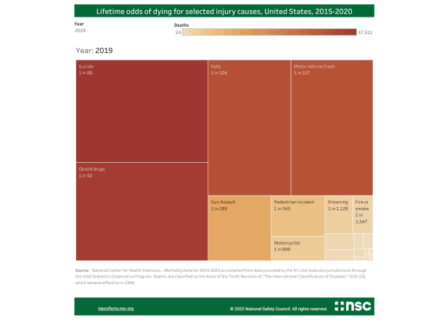
Lifetime odds of dying for selected injury causes in u.s., 2015-2020
In 2019, the lifetime odds of dying due to air and space transport accidents were 1 in 9,446.
The odds of dying by motor vehicle crash were 1 in 107!
Source: National Safety Council
Notes:
In 2019, the lifetime odds of dying to due to air and space transport accidents were 1 in 9,446.
However, the odds of dying by motor vehicle crash are 1 in 107 in 2019 according to National Security Council.

Slide 5
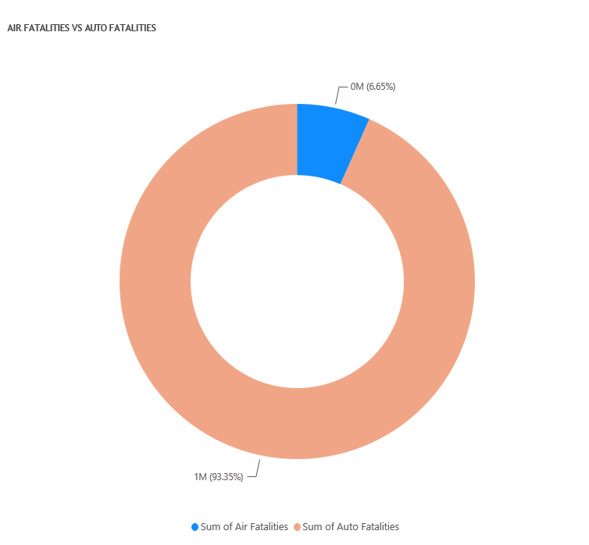
Automobile fatalities account for 93.35% vs. 6.65% for flights over the last 50 years.
Notes:
Over the last 50 years, there have been over 1.1M automobile fatalities compared to less than 79K. A significantly small number for the air travel.

Slide 6
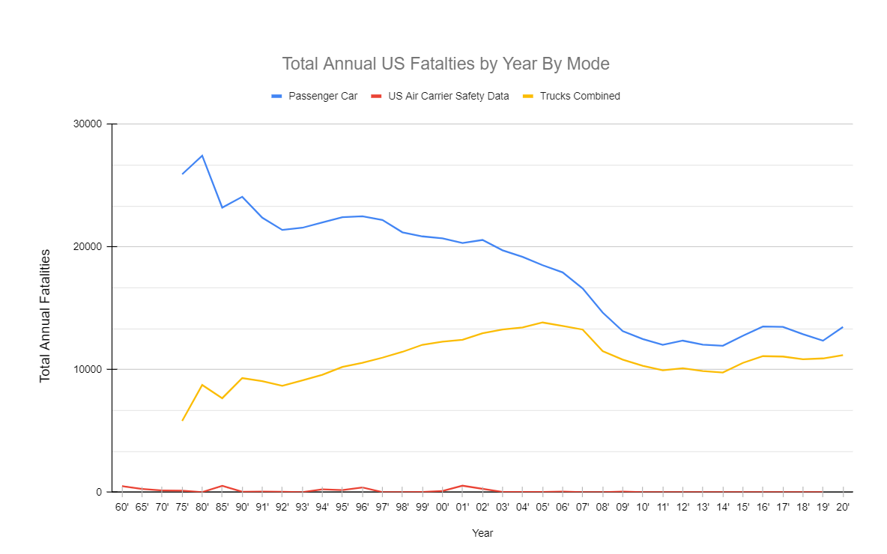
What is the safest mode of transportation in u.s.,then?
Between 2015 & 2020, for passenger cars,
32.28M total crashes
8.8M total injuries
78.4K total fatalities
Between 2015 & 2020, for light and large trucks,
29.8M total crashes
5.7M total injuries
65.6K total fatalities
For the same period, amongst large commercial airlines,
176 total accidents
111 total injuries
5 total fatalities
source for the data and graph: flyfright.com/statistics
Notes:
Between 2015 and 2020, for Passenger Cars, 32.28M total crashes, for light & large trucks, 29.8M total crashes. But amongst large commercial airlines, there have been only 176 total accidents and 5 fatalities.

Slide 7
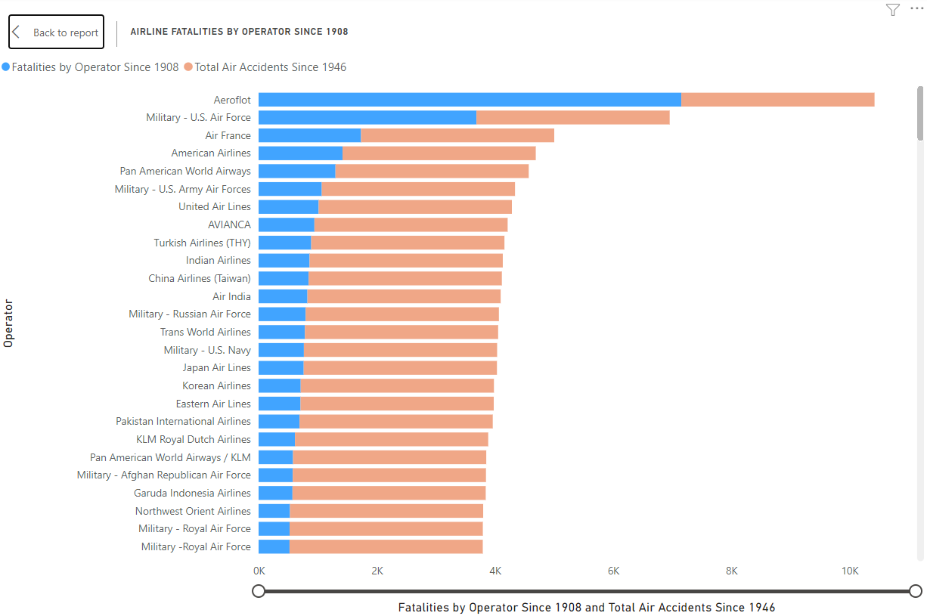
Top 25 Flight fatalities by operator since 1908 – delt air Lines had a total of 319!
Notes:
Since 1908, Delta Airlines have had a total of 319 fatalities.

Slide 8
conclusion
MEDIA REPORTS ARE PATENTLY INACCURATE AND FALSE
THE ODDS OF AIRPLANE CRASH AND DEATH ARE EXTREMELY SMALL
AIR FLIGHT IS STILL THE SAFEST MEANS OF TRANSPORTATION AMONGST OTHER MODES
THUS, FLY WITH DELTA AIR LINES TO TRAVEL SAFER AND FURTHER TOGETHER!
Notes:
MEDIA REPORTS ARE PATENTLY INACCURATE AND FALSE. We Delta Airline believe that flying is still the safest means of travel. We want to reassure you that you can only travel safer and further with us. Together with us!

Slide 9
References:
Airplane crashes (n.d.). Data.world, Airplane Crashes 1908-2009 - dataset by hhaveliw | data.world
Motor vehicle safety data (n.d.). Bureau of Transportation Statistics, Motor Vehicle Safety Data | Bureau of Transportation Statistics (bts.gov)
Preventable Deaths (n.d.). National Security Council, Odds of Dying - Data Details - Injury Facts (nsc.org)
Plane Crash Statistics (n.d.). FlyFright.com, Plane Crash Statistics (flyfright.com)

